Slide 1
Diabetes Readmission Within 30 Days Prediction
MANAL ALENIZI
#TF010

Slide 2

outline
Introduction
Problem statement
Methodology Data preparation
Finding

Slide 3
Introduction
Hospital readmission is a healthcare quality measure that helps in determining the level of quality of care.
The model can identify whether a hospitalized diabetic patient will be readmitted within 30 days or not.
Reducing early hospital readmissions is a policy priority aimed at improving healthcare quality.

Slide 4
Problem statement
Identify the major factors that contribute to hospital readmissions
Measure the influence attribute
Compare accuracy of each model

Slide 5
Methodology
Pre-process, analyze, visualize, and conduct supervised learning on dataset.
Classification algorithm used in order to classify whither patients will readmitted based on the features.
Random forest and decision tree algorithm.

Slide 6
Data preparation and Feature Engendering
Fill missing , encoding, drop useless columns
Ensured data classification were the same
Divided data into testing and validation

Slide 7
prediction
Predicate whether diabetes patients will be readmitted to the hospital based on several factors.
Readmission?
NO
<30

Slide 8
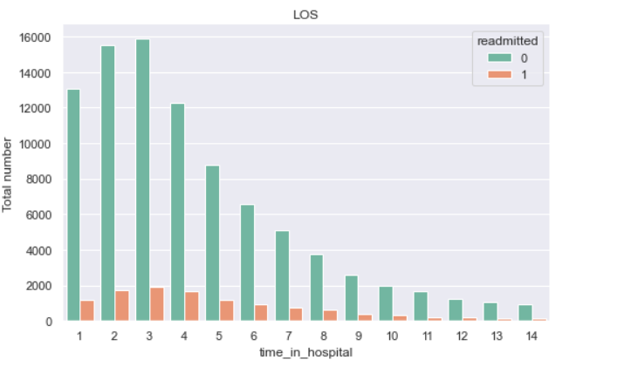
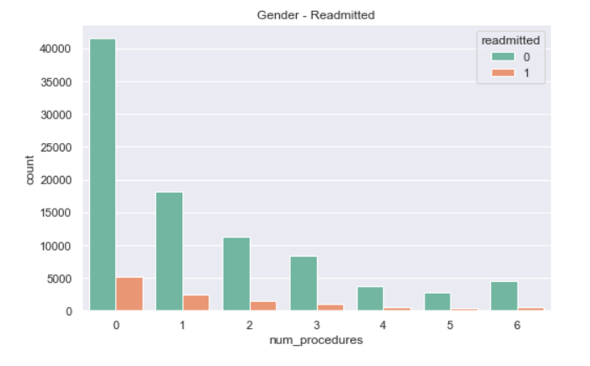
Finding

Slide 9
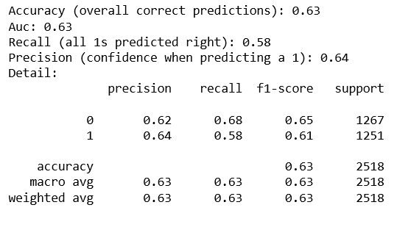
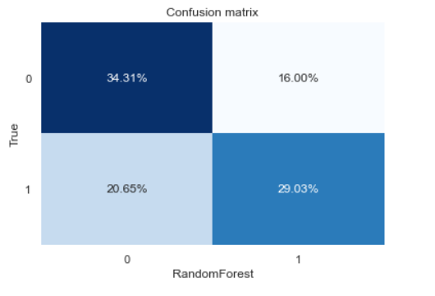
prediction
Random Classifier

Slide 10
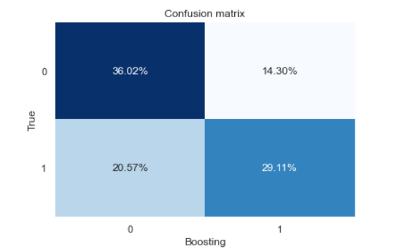
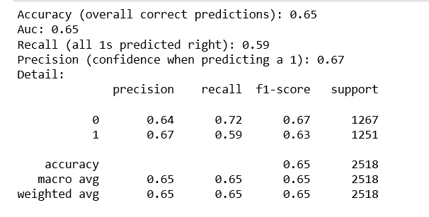
prediction
Boosting Classifier

Slide 11
Basic questions being investigated
What are the top 5 factors that predict a diabetic readmission within 30 days?
If the length of a patients stay in the hospital is predictor of a readmission ?
If the number of procedures a patient entered into the electronic medical record is indicator for readmission ?

Slide 12
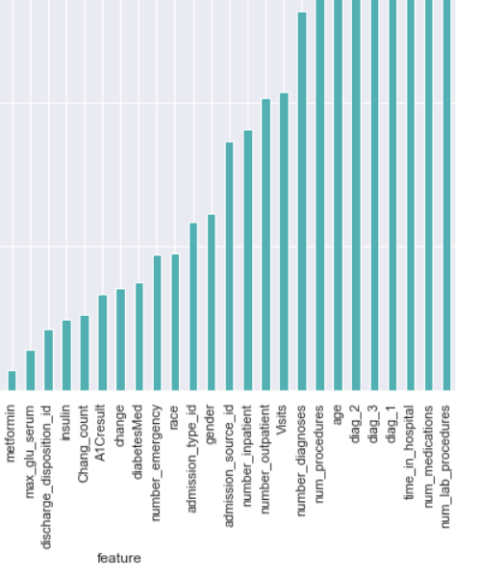
Result
Boosting Forest classification:
Most important factors:
Number of medication.
Number of lab procedures.
Time in hospital.

Slide 13
Future Work
In the future, I’ll try the following to improve the performance of our classifier:
Generate new features.
Neural network.

